Slide 1
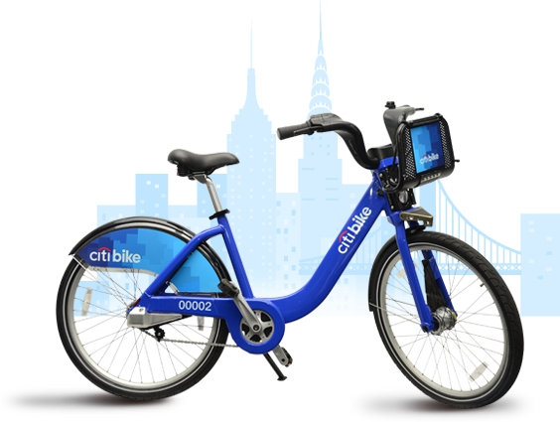
Velocity of CitiBikes
Taraqur Rahman
April 28, 2016

Slide 2
CitiBikes
CitiGroup teamed up with Motivate in 2011
CitiGroup supplies the funds
Motivate supplies the bikes
CitiBike program started May 2013
January 2016 CitiBIke data
509478 X 15

Slide 3
Calculating Velocity
Ending coordinates - Starting coordinates
Duration
Took into account the curvature of the Earth
Numerator is the displacement, not the distance
Velocity =

Slide 4
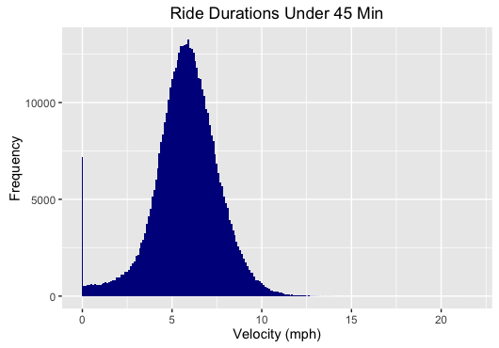
Mean = 5.874 mph

Slide 5
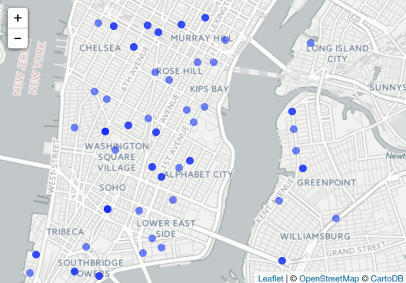
Displacement vs. Distance
Distance
DIsplacement

Slide 6
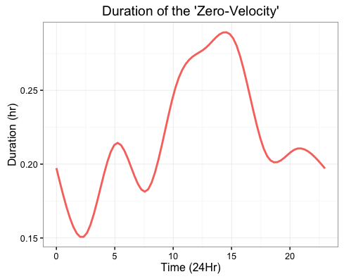

Slide 7
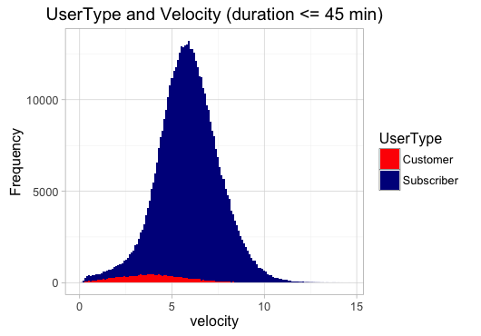

Slide 8
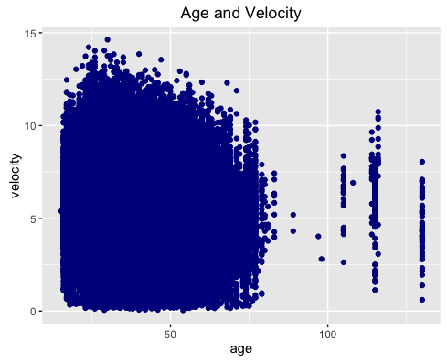

Slide 9
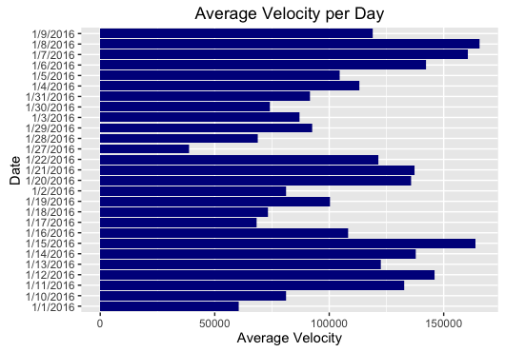

Slide 10
Further Analysis
How velocity is different throughout the year/seasons?
What causes velocity to change?
Where are the bike hotspots?

